Slide 1
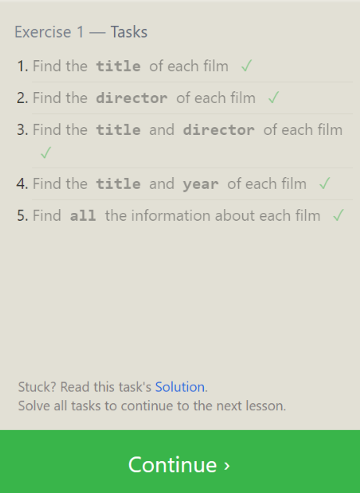
SQL Lesson 1: SELECT queries 101
Answers:
SELECT title FROM movies;
SELECT director FROM movies;
SELECT title, director FROM movies;
SELECT title, year FROM movies;
SELECT * FROM movies;

Slide 2
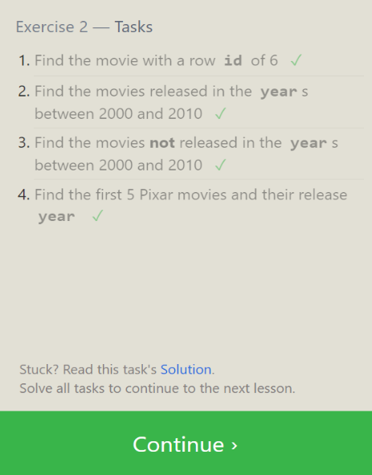
SQL Lesson 2: Queries with constraints (Pt. 1)
Answers:
SELECT * FROM movies WHERE id = 6;
SELECT * FROM movies WHERE year BETWEEN 2000 AND 2010;
SELECT * FROM movies WHERE year NOT BETWEEN 2000 AND 2010;
SELECT * FROM movies WHERE id BETWEEN 1 AND 5;

Slide 3
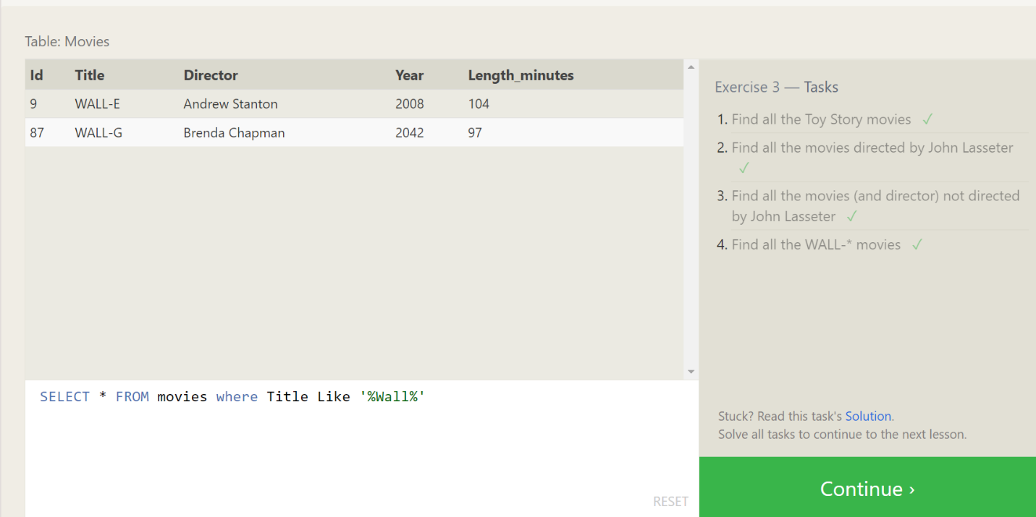
SQL Lesson 3: Queries with Constraints (Pt. 2)
Answers:
SELECT * FROM movies where Title Like '%Toy Story%';
SELECT * FROM movies where Director Like '%john Lasseter%';
SELECT * FROM movies where Director NOT Like '%john Lasseter%';
SELECT * FROM movies where Title Like '%Wall%';

Slide 4
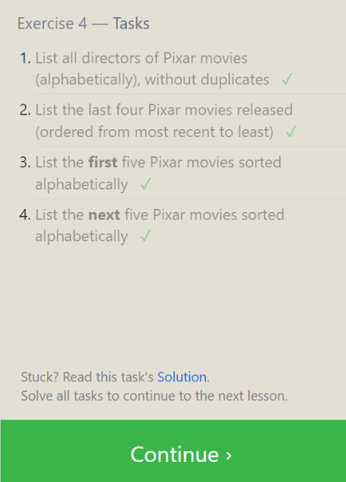
SQL Lesson 4: Filtering and sorting Query results
Answers:
SELECT distinct Director FROM movies ORDER BY Director ASC;
SELECT Title, Year FROM movies ORDER BY year DESC LIMIT 4;
SELECT Title FROM Movies ORDER BY Title ASC LIMIT 5;
SELECT Title FROM Movies ORDER BY Title ASC LIMIT 5 OFFSET 5;

Slide 5
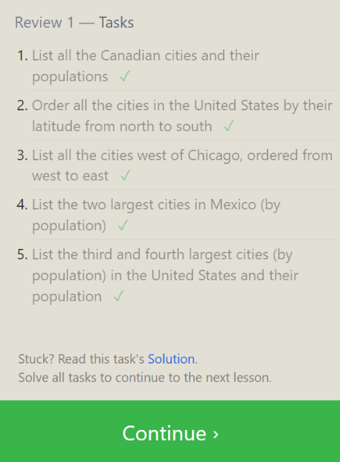
SQL Review: Simple SELECT Queries
Answers:
SELECT City, Population FROM north_american_cities WHERE Country = "Canada";
SELECT City, latitude FROM north_american_cities WHERE Country = "United States" ORDER BY latitude DESC;
SELECT City, longitude FROM north_american_cities WHERE longitude < -87.629798 ORDER BY longitude ASC;
SELECT City, Population FROM north_american_cities WHERE Country LIKE "Mexico" ORDER BY Population DESC LIMIT 2;
SELECT City, Population FROM north_american_cities WHERE Country LIKE "United States" ORDER BY Population DESC LIMIT 2 OFFSET 2;

Slide 6
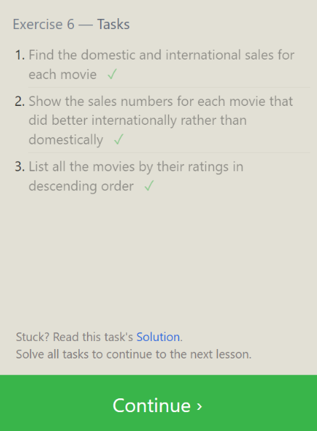
SQL Lesson 6: Multi-table queries with JOINs
Answers:
SELECT Title, Domestic_sales, International_sales FROM movies JOIN Boxoffice ON Movies.id = Boxoffice.movie_id;
SELECT Title, Domestic_sales, International_sales FROM Movies JOIN Boxoffice ON Movies.id = Boxoffice.movie_id WHERE International_sales > Domestic_sales;
SELECT Title, Rating FROM Movies JOIN Boxoffice ON Movies.id = Boxoffice.Movie_id ORDER BY Rating DESC;

Slide 7
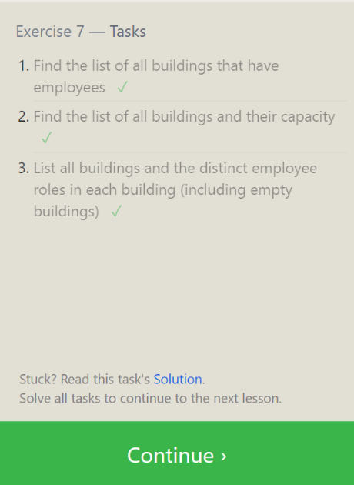
SQL Lesson 7: OUTER JOINs
Answers:
SELECT DISTINCT Building FROM Employees;
SELECT * FROM Buildings;
SELECT DISTINCT Building_name, Role FROM Buildings LEFT JOIN Employees ON Building_name = Building;

Slide 8
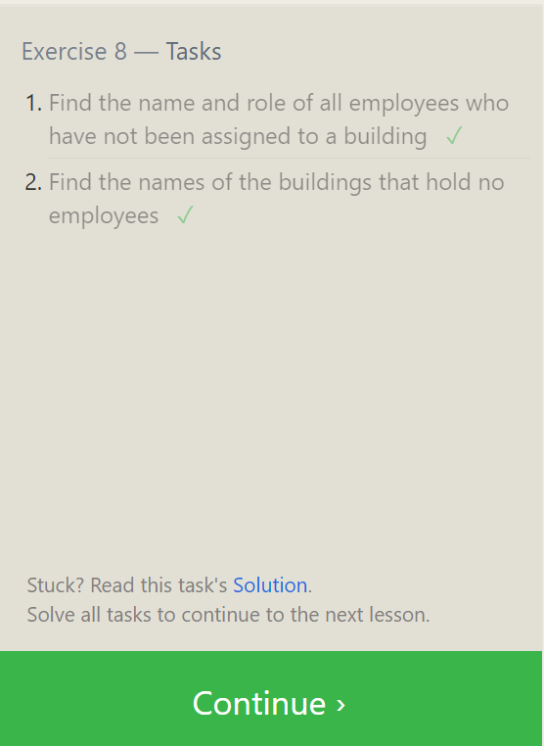
SQL Lesson 8: A short note on NULLs
Answers:
SELECT Name, Role FROM Employees WHERE Building IS NULL;
SELECT DISTINCT building_name FROM buildings LEFT JOIN employees ON building_name = building WHERE role IS NULL;

Slide 9
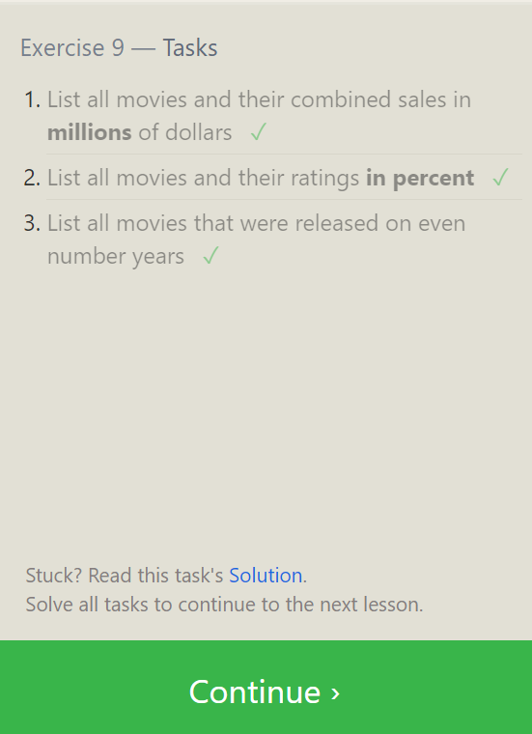
SQL Lesson 9: Queries with expressions
Answers:
SELECT Title, (domestic_sales + international_sales) / 1000000 AS Gross_sales_millions FROM Movies JOIN Boxoffice ON movies.id = Boxoffice.Movie_id;
SELECT Title, Rating * 10 AS rating_percent FROM Movies JOIN Boxoffice ON Movies.id = Boxoffice.Movie_id;
SELECT Title, Year FROM Movies WHERE Year % 2 = 0;

Slide 10
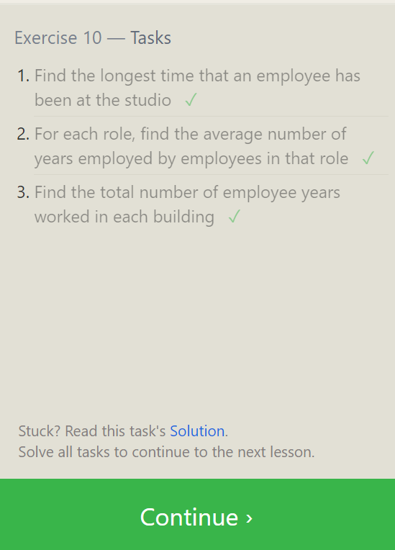
SQL Lesson 10: Queries with aggregates (Pt. 1)
Answers:
SELECT MAX(years_employed) as Max_years_employed FROM employees;
SELECT Role, AVG(years_employed) as Average_years_employed FROM Employees GROUP BY Role;
SELECT Building, SUM(years_employed) as Total_years_employed FROM Employees GROUP BY Building;

Slide 11
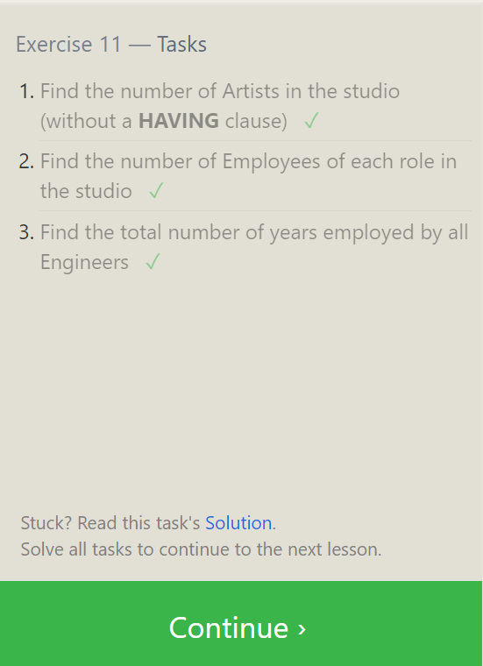
SQL Lesson 11: Queries with aggregates (Pt. 2)
Answers:
SELECT Role, COUNT(*) as Number_of_artists FROM Employees WHERE Role = "Artist";
SELECT Role, COUNT(*)FROM Employees GROUP BY Role;
SELECT Role, SUM(years_employed) FROM Employees GROUP BY Role HAVING Role = "Engineer";

Slide 12
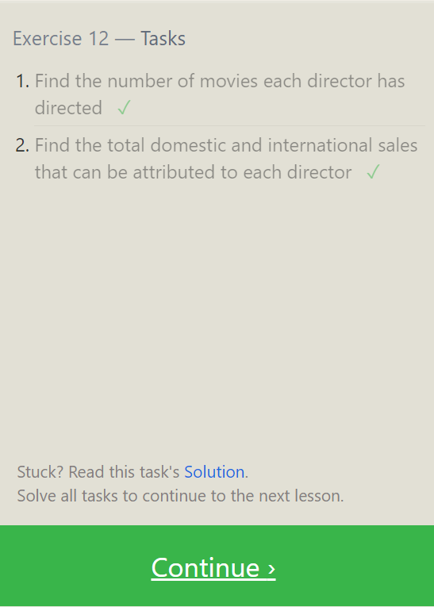
SQL Lesson 12: Order of execution of a Query
Answers:
SELECT Director, COUNT(id) as Num_movies_directed FROM Movies GROUP BY Director;
SELECT Director, SUM(Domestic_sales + International_sales) as Cumulative_sales_from_all_movies FROM Movies INNER JOIN Boxoffice ON Movies.id = Boxoffice.movie_id GROUP BY Director;

Slide 13
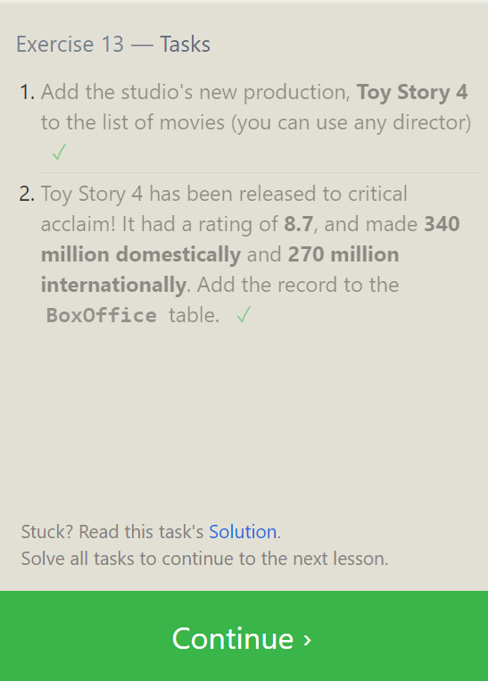
SQL Lesson 13: Inserting rows
Answers:
INSERT INTO Movies VALUES (4, "Toy Story 4", "El Directore", 2015, 90);
INSERT INTO Boxoffice VALUES (4, 8.7, 340000000, 270000000);

Slide 14
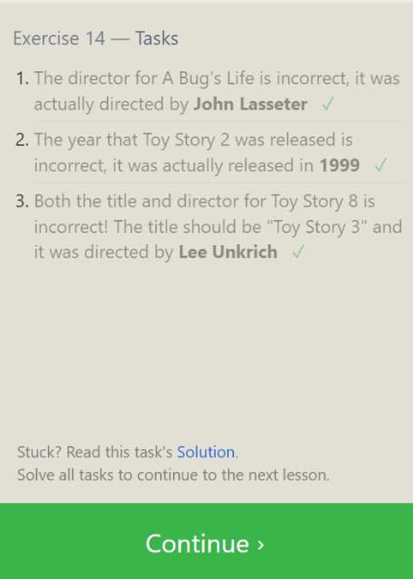
SQL Lesson 14: Updating rows
Answers:
UPDATE Movies SET Director = "John Lasseter" WHERE id = 2;
UPDATE Movies SET Year = 1999 WHERE Id = 3;
UPDATE Movies SET Title = "Toy Story 3", Director = "Lee Unkrich" WHERE id = 11;

Slide 15
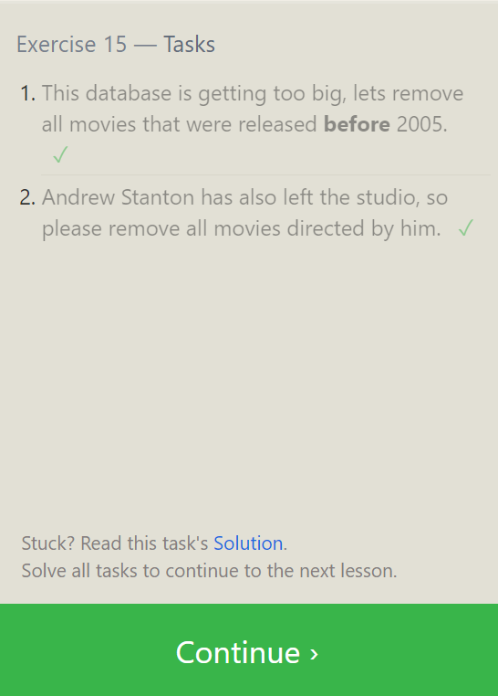
SQL Lesson 15: Deleting rows
Answers:
DELETE FROM Movies where Year < 2005;
DELETE FROM Movies where Director = "Andrew Stanton";

Slide 16
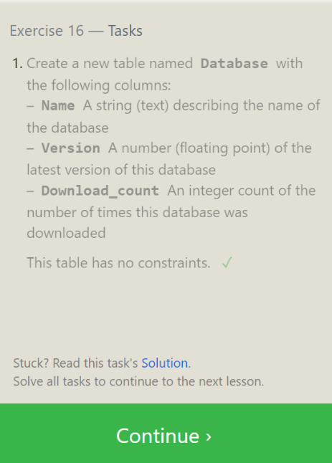
SQL Lesson 16: Creating tables
Answers:
CREATE TABLE Database (Name TEXT, Version FLOAT, Download_count INTEGER);

Slide 17
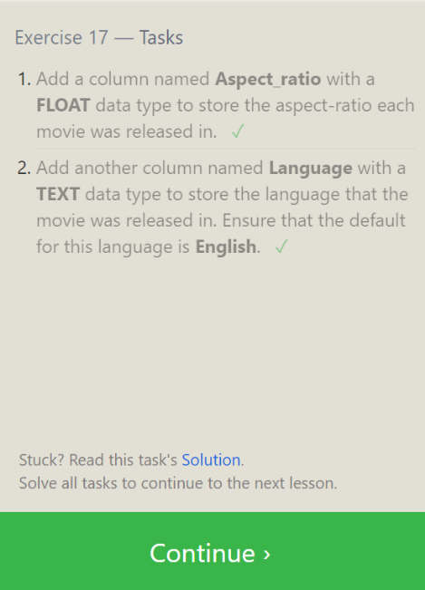
SQL Lesson 17: Altering tables
Answers:
ALTER TABLE Movies ADD COLUMN Aspect_ratio FLOAT DEFAULT 2.39;
ALTER TABLE Movies ADD COLUMN Language TEXT DEFAULT "English";

Slide 18
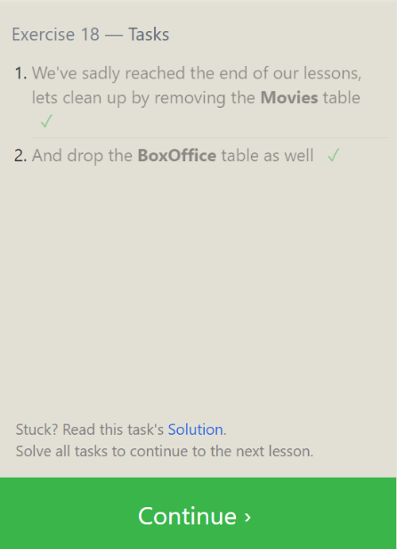
SQL Lesson 18: Dropping tables
Answers:
DROP TABLE Movies;
DROP TABLE BoxOffice;

Slide 19

SQL Lesson X: To infinity and beyond!

